Slide 1
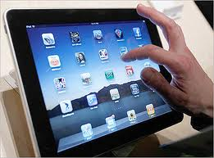
Digital Forensics Update
Presented by: Craig Reinmuth CPA,CFF, MST, EnCE, CGMA President, Expert Insights, P.C. Scottsdale, AZ
(480)443-9064 www.expertinsights.net

Slide 2
Computer Forensics in Each Stage of Litigation Process
Case Strategy
Discovery
Analysis
Testimony
Data preservation
Identify Electronic Evidence Sources
Assist with Cost/ Benefit Discussions with Clients
Interrogatory assistance
Avoid Exposure to Sanctions
For defense, view what is/is not on computer
TRO
Attend Meet and Confer
Types of Electronic Evidence to Request
Secure Collection & Preservation
Detect use of Storage Devices/ Data Downloads
Motion to Compel
Opposing Expert –
Deposition/Rebuke
Findings
Attend meetings with Judge
Getting all data needed to represent client
Determine user intent
Restoration of
Deleted Files
Review all relevant ESI
Printing/burning activity
Internet activity
Spoliation of Evidence
Knowledge of case law
Defendable Reports
Understandable Testimony
Integrity of Data
Vulnerability Assessment
Opposing Expert Cross Examination
Prior Experience Reputation
Notes:
Enhancing your ability to win cases

Slide 3
What’s new?
Computer Forensics is now
Digital Forensics
Smartphones
Cloud Storage
Social Media
Technology Assisted Review (“TAR”)

Slide 4
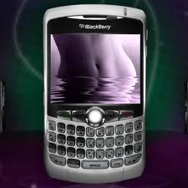
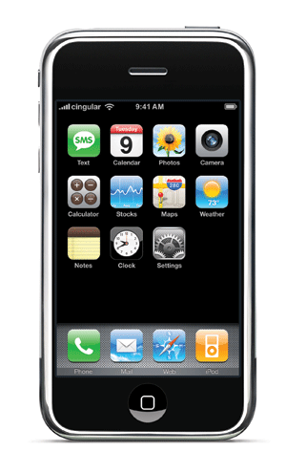
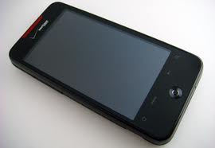
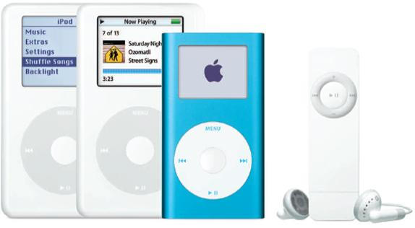
Computer Forensics is now Digital Forensics
Notes:
The field of information technology is moving so fast that CF is now DF
Text messaging becoming the more common way to communicate (80% of cell phone owners text)
email turning into web mail
Pictures being taken and never being transferred anywhere else, or
Files being downloaded from corporate server onto HH devices
More and more infor is being stored right here or in the cloud
Especially when people are involved in illegal or litigious activities and they don’t want it to be found anywhere else.
So if you want the information, you need to seriously consider these new sources of storage.

Slide 5
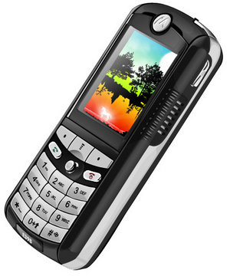
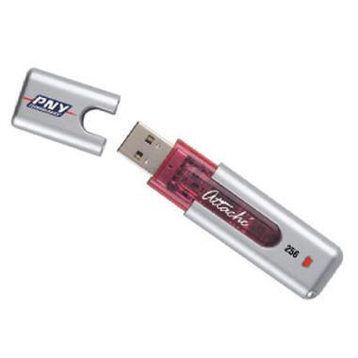
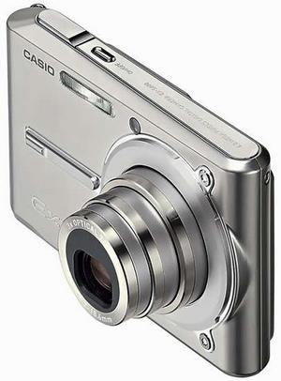
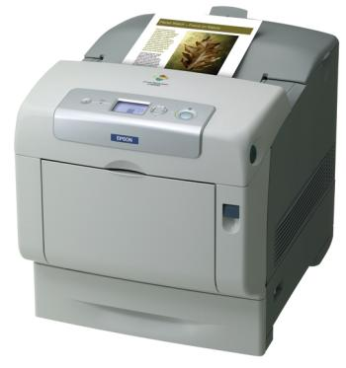
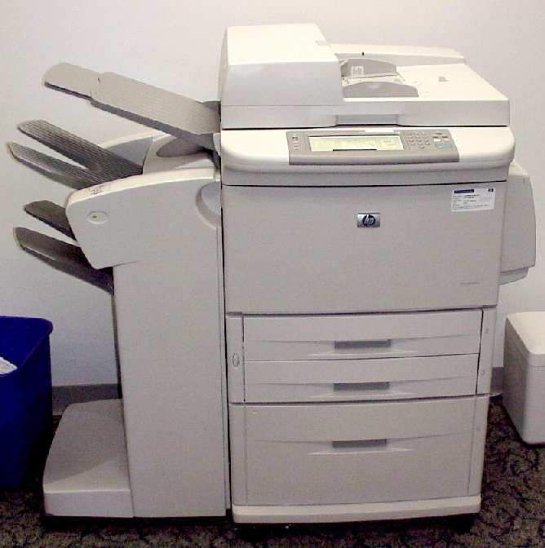
Consider Other ESI Locations
Notes:
Can be forensically obtained and examined.

Slide 6
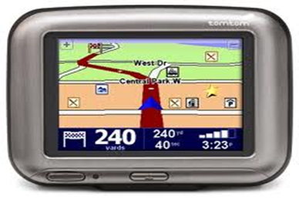
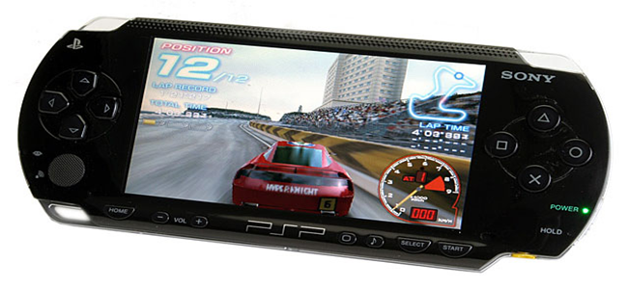
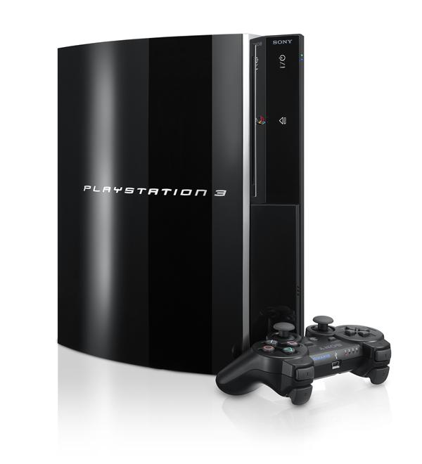
Consider Other ESI Locations
Notes:
GPS devices, and YES, even children’s electronic toys
Back up drive can now easily download the contents of one, but more than one, desktop or laptop drive content
Recent case where FINANCIAL files were hidden on a Kindle!

Slide 7
What’s new?
Computer forensics is now digital forensics
Smartphones

Slide 8
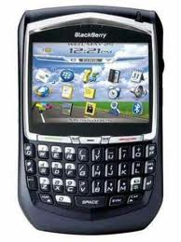
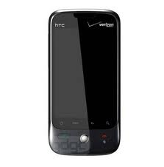
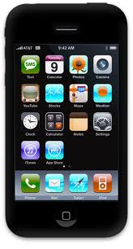
Data on Smartphones
On the Device
Other items uncovered
Call logs
Text messaging
Pictures
SIM card information
Emails and attachments (e.g. Outlook)
Phone directories
Internet history
GPS tracking
Remote access programs (e.g. Log Me In, VNC, Homepipe)
Web based email – specific providers
Where else to go to get info
Notes:
These devices are mini computers.
- Critical communication is no longer going to their laptop or desktop computer. It’s stopping right here.
ESPEC if they are up to no good…Communication, and now even file transfers are NO LONGER GOING TO COMPUTER,
The information you may be looking for is stopping right here! – can’t emphasize this enough

Slide 9
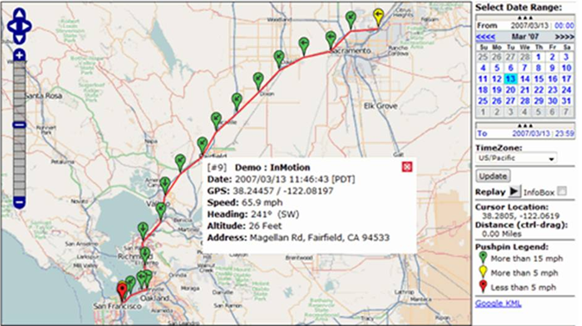
GPS tracking
Notes:
GPS logs can tell you where that phone was and when
(Starbucks at this location at such and such time)

Slide 10
Get Head Into the Clouds!
Notes:
Cloud computing = storing information remotely via use of external providers
Corporations are moving away from large “server” rooms.
Here to stay and rapidly growing in popularity

Slide 11
What’s new?
Computer forensics is now digital forensics
Smartphones
Cloud Storage
Social Media

Slide 12
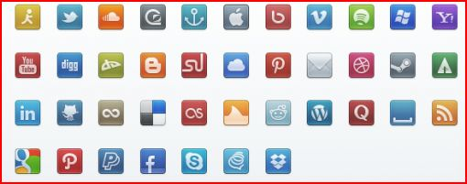
Social Networking -Obtainable Data
Notes:
Social media- not only social networking sites like Facebook, twitter, also includes web based email
Facebook - over 500 million users
Twitter - over 100 million, with 230 million tweets per day!
Fortunately, there is forensic software that can grab this data to extent it resides on the computer or phone if it may be important to your case.

Slide 13
Recent decision
I see no principled reason to articulate different standards for the discoverability of communications through email, text message, or social media platforms.
-Magistrate Judge Paul Papak
Robinson v. Jones Lang Lasalle Ams., 2012 U.S. Dist. LEXIS 123883 (D. Or. Aug. 29, 2012)
Notes:
Recognizing that social media is simply another form of ESI:

Slide 14
What’s new?
Computer forensics is now digital forensics
Smartphones
Cloud Storage
Social Media
Technology Assisted Review
Notes:
Technology assisted review (of ESI) aka predictive coding
– Judge Facciola stepping out and encouraged its consideration in Disability Rights Council of Greater WA v. Wash. Metro Transit
Judge Grimm is also a proponent of these technologies
Rising in popularity to assist with the lowering cost of e-discovery

Slide 15
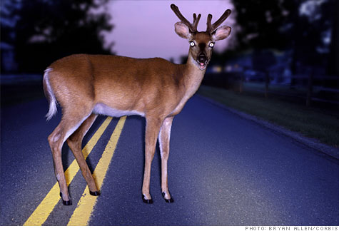
Quick Facts……
92% of information is
created on computer;
90% is never printed!
5.5 billion cellphones
1.2 billion computers
200 cases/year on e-discovery issues
“Reasonable accessible”/”Undue burden”
“Willful”
“TAR” (Technology assisted review)

Slide 16
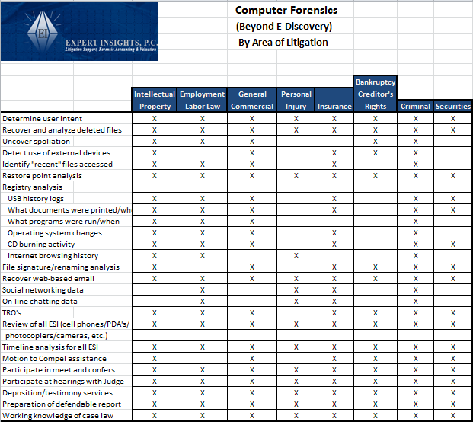
Notes:
Distinguishing between CF and ED.
Across the top select the type of litigation you are involved in
On the left hand side is the type of information you cannot get with normal e-discovery, but you can get with computer forensics
-includes recovery of deleted files, uncovering spoliation, when storage devices were connected, etc.
Something to keep in mind when you get calls from “e-discovery vendors”

Slide 17
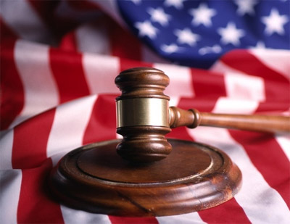
Case Examples
Meet and Confer Requirements
Spoliation
Adverse Inference
Breach of fiduciary duty
Personnel
Defense Case Strategies
Notes:
Now I’d like to share facts and ruling on just few of the cases I have personally been involved in
that touch on these areas

Slide 18
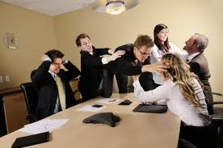
Meet and Confer
Judges want &
need cooperation
Start on right foot
and stay there
New E-Discovery Guidelines issued by
ND California (www.cand.uscourts.gov)
Notes:
In general, Judges hate to hear discovery disputes
New guidelines provide:
Guidelines for Discovery of ESI
Checklist for Rule 26 Meet and Confer Sessions
Model Stipulated Orders

Slide 19
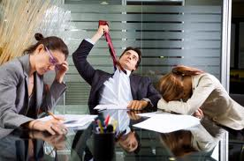
Case Examples… Meet and Confer
Department of Justice was Plaintiff
They “want it all”
Negotiated down from 26 computers to 2
Search terms with millions of search hits
Agree on statistical sampling approach for residual
If not reasonable go to Judge
Have digital forensics expert at meetings/hearings
United States of America vs. Business Recovery Services No. 2:11 CV-390
Notes:
US vs. BRS = Case I was involved in. telemarketing sales rule case.
With Cases against Fed Gov, - need to put on a different hat!
They think they can run the show in getting what discovery they want (and usually the Judge will stand up for them)
If vindictive opponent, and their request turn into undue burden for your client,
come up with cost estimate and request cost sharing.
Other tips:
There are software tools that can index the data and tell you how often words appear in d/base – helps
If you can’t afford to do it right; can’t afford to do it wrong
Sample size; confidence intervals

Slide 20
Case Examples… Meet and Confer
Defendant got behind 8-ball; put boxing gloves on too early
Motion to Compel Granted; Plaintiff in driving seat
Counsel contacted EI
Worked out plan for 12 computers vs. 40 in entire department
Limited key words initially
Indicated State’s position was correct
Judge granted MSJ after State was complying with Case Management Plan and had computer expert engaged
Misturini vs. State of Arizona No CIV10-2327

Slide 21
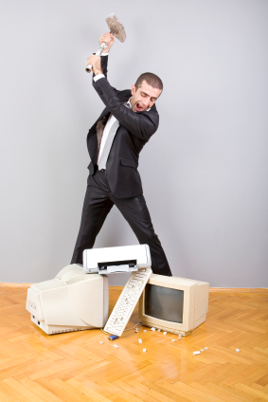
Case Examples… Spoliation
USB devices attached to computers
Database had been stored on USB’s
Other CF expert “Don’t see it”
Photo’s/other large files d/loaded,
overwriting d/base files
Judge set hearing date set for sanctions
Case settled
American Family Insurance v. Willey CV 07-cv2037
Notes:
Spoliation - Personally love spoliation cases = Win/Win
-sanctions, adverse inference instructions, have case thrown out

Slide 22
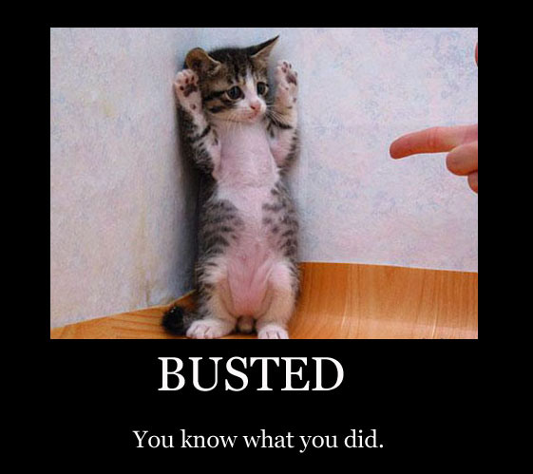
Case Examples… Spoliation
Launched public relations campaign against
company that fired him (blogs, redirects
from company website, etc.)
Defendant claimed hard drive crashed
Computers provided had little business data
Refused to turn over smartphones
CF determined phone was synced to computer
Text and web-based mail contradicted deposition testimony; disclosed direct involvement with bashing campaign
Sanctions awarded
Aviva USA v. Vazirani 2:11CV-0369
Notes:
Aviva
All information was backed up from phone was on computer

Slide 23
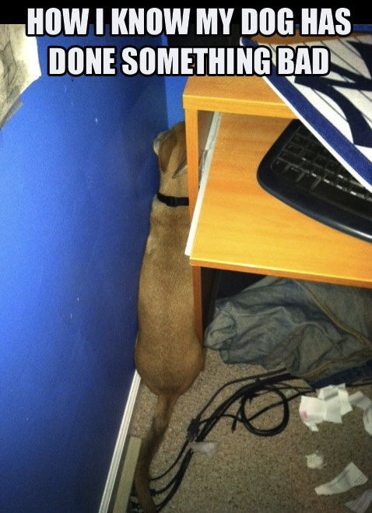
Case Examples… Spoliation
Defendant produced two computers
Defendant “I provided all computers I used”
CF Analysis identified third
When threatened with Motion to Compel;
admitted to third
Rule 16(f) violation – failed to obey a
scheduling or pre-trial order
Sanctions imposed for attorneys fees/costs
Case settled in favor of Plaintiff
American Family Insurance v. Kuemmerle cv07-00802

Slide 24
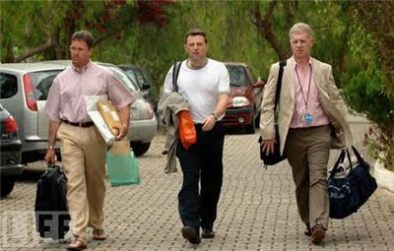
Case Examples… Spoliation
Intelligent Engineering Executive
left company with two others
Had developed new products
Corporate computer demanded
Hard drive imaged; business files not all there
CF determined hard drive on corporate computer was new
Only select business files transferred to new hard drive
Proprietary files remained on hard drive retained by former employee

Slide 25
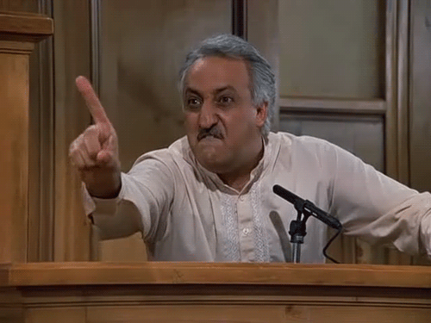
Adverse Inference
Applies to your experts
Plaintiff disabled in ATV crash
Claimed manufacturer default
Expert witness report agreed
During deposition of expert, counsel for Defendant was able to determine more photo’s likely existed
Expert provided 32 additional photo’s
Second deposition revealed “failed hard drives”
Imaged hard drives; found 54 photo’s not used in report or previously disclosed; nine critical to case
Stepping stones exhibit; adverse inference instruction given by Judge
Johnson v. American Honda CV-10-126-M
Notes:
American Honda in Montana. Personal injury case.
Can apply to work product of any expert – if you believe all has not been provided
Determined the new photos were placed on HD two weeks prior to date of report and accessed multiple times prior to completion of report
Counsel asked me to determine, and testify as to what are the chances of the expert selecting and providing 32 of the 54 photos without providing any of the 9 critical photo’s

Slide 26
1 in 10,695 Chance
Notes:
Counsel asked me to determine, and testify as to what are the chances of the expert selecting and providing 32 of the 54 photos without providing any of the 9 critical photo’s
So I came up with this visual of someone trying to cross a stream of water with:
54 stones to choose from
9 of which contain landmines and
Had to take 32 steps to get across
Adverse inference instruction to jury (tried to get case thrown out)

Slide 27
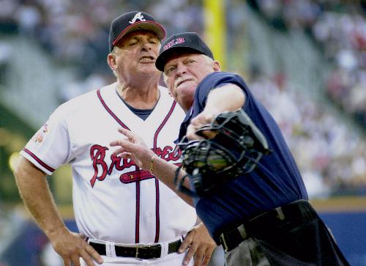
Case Thrown Out
Executives left company and started their own competing business
Examined computers at old and new company
Testified at spoliations hearing
Used same wiping software on both!
“Adverse inference instruction or in conjunction with monetary sanction would be insufficient cure”
Science Care v. Genlife Institute CV2009-032397
Science Care v. Goyette, et al CV 2009-032397
Notes:
Science Care – I believe this was the first case in AZ Superior Court where the case was thrown out based on spoliation of evidence(Linda Miles)
We were asked to determine what proprietary data they might have taken with them electronically.
Old computers - clearly info that s/h been on corporate computers was not
- determined a wiping program was used to permanently delete 702,000 files from SC computers
- determined high tech USB devices were attached and proprietary programs d/loaded; they were destroyed or missing
-prefetch files indicated existence of wiping program “Secure Clean”
New computers at new company - used same wiping program after the litigation started
****Judge Linda Miles “Defendant’s conduct cannot, by any stretch of the imagination, be characterized as innocent or unintentional”
Judge Miles considered other cases in Ninth Circuir in CA and Montana
Case thrown out; separate hearing on damages including legal and expert fees

Slide 28
Breach of Fiduciary Duty
GP for a number of real estate LP’s
GP had major surgery out for months
recovering in Hawaii
Suspicious of other partners activity
during his absence
Deleted (and recovered) emails
To current investors
To new “in cahoots” partner
SDI vs. Sun Valley Investors

Slide 29
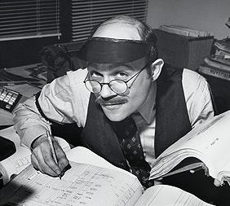
Breach of Fiduciary Duty
GP for a number of LP investments
100’s of LP’s entrusted them with their $
Forensic accountant involved; couldn’t put finger on it
Attorney wanted to look at server
AJE’s on server w/o support
Separate set of electronic records in GP office; filtered investor $ and other entries here first
Schupak v. 75th Avenue & Peoria Investors CV2009-009667
Notes:
Schupak
Forensic accountant - Doing pretty good job; but not smarter than the average bear.
Attorney was though and decided to call me in to take a look at corporate server.
I was able to determine the actg info on the server contained certain AJE’s w/o any detail to support them.
One of the officers of the GP had an electronic set of books on his corporate computer in his office.
This set of electronic books contained transactions that funnelled investor monies and a # of other transactions through his set of books and he would then just post an AJE to the corporate books on the server.
(Can’t use in TB presentation) - Gomez
Another case, one partner had an idea, other partners had $. Involved $ remaining invested for # of years
Part of deal was to fund LE of ptr with/idea until properties purchased at a steal turned around in price
After market began to turn around

Slide 30
Personnel Case Example – Without Digital Forensics
7/14 (evening) Human Resource Department receives email from EE indicating he/she wants to meet with boss the next day
7/15 Terminates employment
Notes:
Here is an example from a recent case we worked on involving an employee who left the company to go with a competitor
Your client comes to you and indicates (2 from above)
And that they are suspicious, since she went with a competitor, that she may have taken proprietary info with her
Without computer forensics, this is all your client will know

Slide 31
Personnel Case - Timeline
6/6 Warm fuzzies re: business r/ship (gmail)
6/11 Go to social event together (gmail)
6/15 Forwards resume to competitor (gmail)
6/17 Competitor invites EE to meeting on 6/19 (gmail)
6/19 EE attends meeting at competitor office (gmail)
6/20 (Sat) Install 1TB Backup storage device (USB)
6/20 Accesses company projects on server(recent)
6/20 (eve) Accesses company projects on server(recent)
6/20 (eve) Goes to Google documents account (cookie)
6/21 Apple computer in EE possession (deleted email)
6/22 Project files sent to competitor (gmail)
Notes:
With the use of computer/digital forensics we were able to uncover the following…..

Slide 32
Timeline (continued)
6/22-6/28 Employment negotiations (gmail)
6/25 EE connects USB thumb drive in LT (USB)
6/25 EE accesses server/files from home laptop (recent)
7/8 EE connects card reader for first time (USB)
7/8 Empties trash (recover deleted files)
7/14 (evening):
EE connects same backup drive to laptop (USB)
EE accesses project files from server (recent)
Email indicating EE wants to meet with boss (gmail)
EE communicating with b/friend re: computer on BB (phone)
EE access web mail account; forwards “opportunities” file (internet activity)
7/15 Terminates employment (from client)
Notes:
Even with e-discovery, none of this additional information could have been determined
Important to distinguish between e-discovery and computer forensics

Slide 33
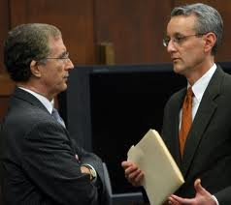
Defense Side Computer Forensics
Is your client telling you “the whole truth”
Be Proactive
Up-front strategy
Information on your clients’
computer they did not put there
Assist with demands of opposition
Turn claims into counter claims
Working knowledge of case law
Rebuke opposing experts’ credentials/methodology/findings
Deposition line of questioning
Notes:
How can CF expert assist you in this role?
On the defense side, there are also benefits of considering the use of CF:
- client telling whole truth….Boardman example
Allows you to be comfortable in being proactive in your approach and strategy to the litigation
-when opposing counsel calls you to obtain ESI from your client, you know in advance what is and is not on your clients computers
--comfortably tell him, “sure will make the data available to you….have at it” (knowing they will be wasting their time)
If you are on the defense, you need all the ammunition you can get to fight back; perhaps level the playing field

Slide 34
A Word on Costs
$
Notes:
size of HD’s and servers compounding
-1 TB = Cardinals stadium
- new technology and devices and plethoura of locations of where data resides
- cloud computing
- Solid state drives
- ya da, ya da
Ways to reduce costs:
Targeted collection – pre-program USB device
Indexing of documents (to assist with keyword searches)
More sophisticated review techniques
TAR still being tested. Can we allow the computer to be smarter than us? Keep an eye on it
Smartphone – consider chances
Sampling methods using sample size; confidence intervals, etc.
But continue to keep in mind the benefits
93% of information on a computer is never printed out; nothing on a phone is!
So if you’re going to appropriately represent your client, need to go where the data is
Many examples as to how you get to victory quicker with the pursuit of electronic data
Look for an Expert who will work with you and think things through
- whether you’re trying to limit e-discovery by the other side, or
- get all the data you need to properly get the job done
When looking for an expert:
- find one who is simply be responsive (these documents between these dates), instead
- someone who will be proactive
-truly understand the nature of the litigation you are involved with
-has an good understanding of case law on electronic evidence
-help you u/stand what you and your clients responsibilities are
-where you can draw the line in the sand
-who knows about all aspects of a hard drive and where data resides
I know it’s commonly a tough decision for you and your clients, but I hope the practicle examples I’ve shared with you illustrate how getting data from the computer can help you do the most important thing…WIN YOUR CASE!

Slide 35
Thank you!

