Slide 1
Make the Pursuit of Digital Data Work for You ….and Not Against You
Presented by: Craig Reinmuth CPA,CFF, MST, EnCE, CGMA President, Expert Insights, P.C. Scottsdale, AZ
(480)443-9064 www.expertinsights.net

Slide 2
Digital…it’s how we live!
Get up in the morning and check:
Text/email messages or Facebook account
On way to work place calls, leave voice mail or email message via smartphone
At work respond to phone/ email messages
Access accounts on corporate server or desktop/ laptop computer
Make copies on copy machine
Make a bank transfer online
Transfer data to cloud or external storage device

Slide 4
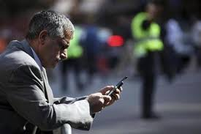

Slide 5
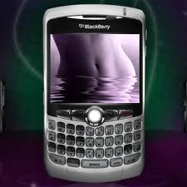
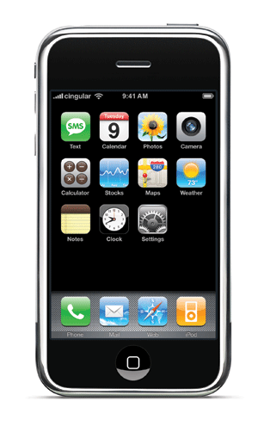
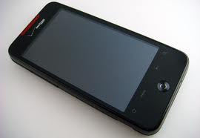
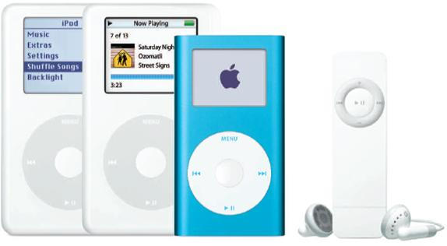
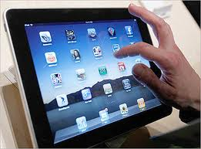
Digital Data Devices

Slide 6
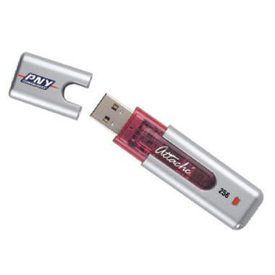
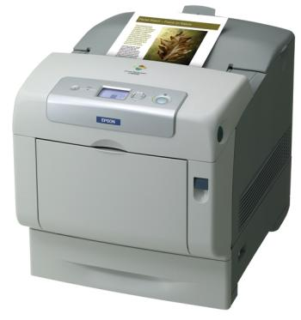
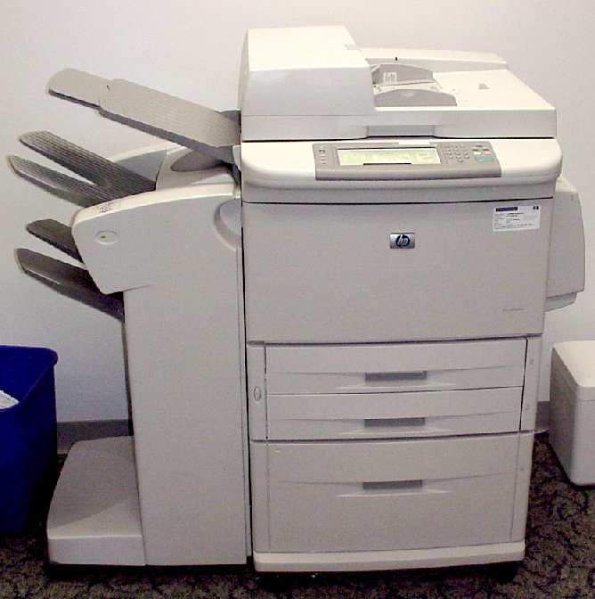
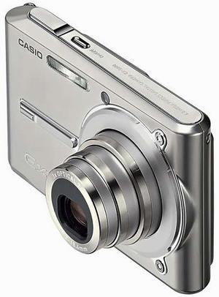
Consider Other ESI Locations

Slide 7
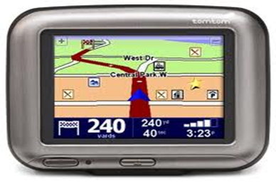
Consider Other ESI Locations

Slide 8
Ok…So How Do I Get it?
Put digital data on Client Checklist
Preservation letter at onset
Most Judges now understand
Likely a community asset

Slide 9
What is Needed to Compel
Some form of proof the relevant data is on the device
Subpoena other parties
Prove it is the only location evidence exists (can’t get via other means)

Slide 10
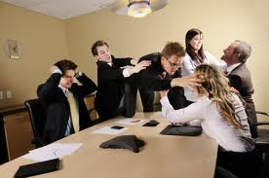
Negotiating with Opposing Counsel
Point out specific relevant information your client is aware of
Examples/nature of spouses’ business
Meet and Confer
Work out a mutually comfortable plan
Terms, time frames, privileged terms
Form of production (native)
Be up front and direct

Slide 11
What if Opposing Counsel or Their Client “Doesn’t Get It”
Motion to Compel (get help)
Request early case assessment of CF expert
Include CV of CF Expert (with appropriate level of experience)
Ask CV expert to provide protocol
Shows Judge you have everything in control and Judge does not have any risk in granting your Motion
Discovery Master or CF Expert

Slide 12
Authority of Special Master
Naturally, governed by Minute Entry
Rule 71: SM to make all measures necessary or proper for the efficient performance of their duties
Includes ruling on admissibility of evidence
“Likely to lead to discovery of admissible evidence”

Slide 13
Working with Special Master
Search terms/dates
Filtering
Who will review for relevancy
Document protocol at onset

Slide 14
What to Look for in a Good Computer Forensic Expert
Years experience; Been there done that
Well respected by counsel and judges
Proper credentials
Make sure they remain current
Similar cases? Ask for sample report
Ways to make sure you got it all
Knows where to look (vs. you telling them)

Slide 15
Digital Forensics in Each Stage of Litigation Process
Case Strategy
Discovery
Analysis
Testimony
Data preservation
Identify Electronic Evidence Sources
Assist with Cost/ Benefit Discussions with Clients
Interrogatory assistance
Avoid Exposure to Sanctions
For defense, view what is/is not on computer
TRO
Attend Meet and Confer
Types of Electronic Evidence to Request
Secure Collection & Preservation
Detect use of Storage Devices/ Data Downloads
Motion to Compel
Opposing Expert –
Deposition/Rebuke
Findings
Attend meetings with Judge
Getting all data needed to represent client
Determine user intent
Restoration of
Deleted Files
Review all relevant ESI
Printing/burning activity
Internet activity
Spoliation of Evidence
Knowledge of case law
Defendable Reports
Understandable Testimony
Integrity of Data
Vulnerability Assessment
Opposing Expert Cross Examination
Prior Experience Reputation

Slide 16
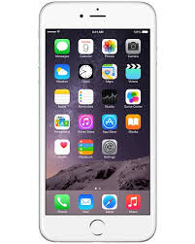
Data on Smartphones
On the Device
Other items uncovered
Call logs
Text messaging
Pictures
SIM card information
Emails and attachments (e.g. Outlook)
Phone directories
Internet history
GPS tracking
Remote access programs (e.g. Log Me In, VNC, Homepipe)
Web based email

Slide 17
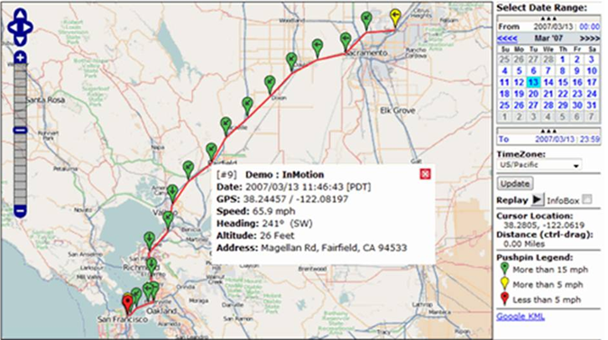
GPS tracking

Slide 18
Social Media -Obtainable Data

Slide 19
Practical Examples for Family Law Cases
“Pictures are like a thousand words”
Watch what you say!
Double set of books
Internet concerns
Unknown relationships
Questionable spending/trips
Unknown bank accounts/deposits

Slide 20
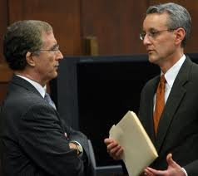
Defense Side Digital Forensics
Is your client telling you “the whole truth”
Be Proactive
Up-front strategy
Information on your clients’
computer they did not put there
Assist with demands of opposition

Slide 21
Thank you!

Slide 22
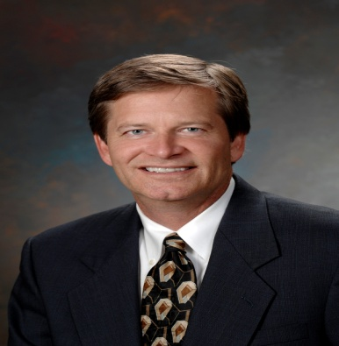
craig@expertinsights.net www.Expertinsights.net
Craig Reinmuth is President of Expert Insights, P.C., a litigation support firm specializing in the digital forensics and forensic accounting, providing services to legal communities nationwide. Craig is a well-known speaker and article writer in his field. He has testified as an expert witness in Federal District Courts as well as District and Superior Courts in the States of Arizona, California, Nevada and Wisconsin.
Craig particularly enjoys the expert witness testimony aspect of his work wherein he is able to bring facts and insights to judges and juries to assist them in upholding justice in the courtroom. He is known for working with counsel throughout the course of the litigation including strategic planning, pursuing relevant discovery and finding alternate means to obtain it, detailed analysis of discovery and providing clear and convincing testimony.
Professionally, Craig is a Certified Public Accountant, Certified in Financial Forensics, a Chartered Global Management Accountant, and an EnCase Certified Examiner. He is past chairperson for the Business Valuation and Litigation Support Steering Committee for the AZ Society of CPA’s.

