Slide 1
Using and Challenging Forensic Digital Evidence

Slide 2
Presenters
Craig Reinmuth, President, Expert Insights, PC
Craig’s litigation support firm specializes in digital forensics and forensic accounting, providing services to the legal community nationwide. He is a well-known speaker and article writer in his field and has testified in over 50 cases across the U.S. He can be reached at Craig@ExpertInsights.Net.
Michael R. Arkfeld, Arkfeld and Associates
Michael is the author of Arkfeld on Electronic Discovery and Evidence treatise and Best Practices Guides. He is a former assistant United States Attorney and is the Director of the Arkfeld eDiscovery and Digital Evidence Program at the ASU College of Law. He can be reached at michael@arkfeld.com.

Slide 3
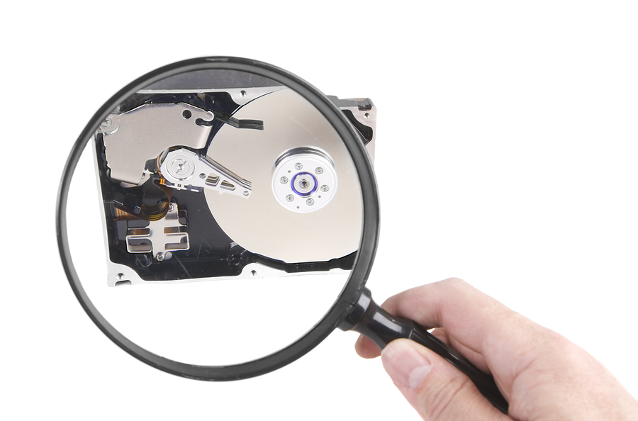
Agenda
What is Computer Forensics and Why is it important?
Computer Forensic Image, Active Files Backup and Hashing
Creating, Deleting and Recovering ESI
Anti-computer Forensics
Alteration of ESI

Slide 4
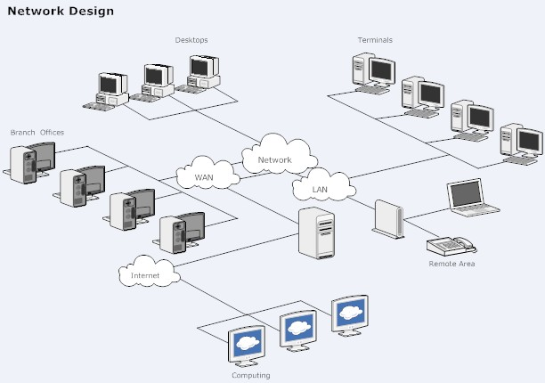
Computer Forensics and Electronic Discovery
Computer forensics involves the identification, preservation, extraction, documentation, and analysis of computer evidence.
Electronic discovery is primarily the request, collection, review, production and management of electronic information.
Notes:
Similarity: Both in pursuit of ESI relevant to litigation
Difference ED is reactive
CF is proactive
CF enhances ED efforts in locating relevant data especially in cases where:
opposing counsel isn’t comfortable with TAR and possibly leaving 30% behind, or
your attorney for the plaintiff and you want to maximize your chances of getting any and all ESI you can get your hands on to support your case
Request identify
Collection Extraction
management preservation
Production documentation
Review analysis

Slide 5
Digital…it’s how we live!
Get up in the morning and check:
Text/email messages or Facebook account
On way to work place calls, leave voice mail or email message via smartphone
At work respond to phone/ email messages
Access accounts on corporate server
Make copies on copy machine
Make a bank transfer online
Data transferred to cloud or storage device
Notes:
Let’s face it, most of us do the following:
You have been leaving an electronic trail all along the way (and so do the people you are litigating against)
Even if someone tries to delete any of this info, likely can be recovered by a computer forensic expert, and
If they wipe the data, they are in even bigger trouble.
This is the world we and your litigants live in and why electronic data needs to be on the forefront of you discovery requests.

Slide 6
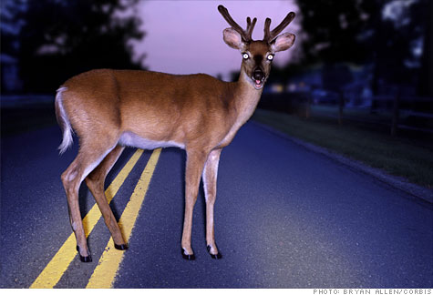
Quick Facts……
93% of information is
created on computer;
90% is never printed!
5.5 billion cellphones
1.2 billion computers
200 cases/year on e-discovery issues
Sanctions (Spoliation, Legal/expert costs)
Adverse inference instructions
Cases thrown out
Turning claims into counterclaims
Notes:
Some Quick facts………..
Should be an initial lightbulb as to the importance of considering cellphones for evidence
There are now 200+ cases/yr
but you should view this as presenting new ways for you to win your litigation including:
Sanction awards for spoliation
New ways to recover litigation costs for your clients
Winning cases quicker for clients including adverse inference and having cases thrown out
Allow ESI and computer forensics to work for you rather than against you
-Michael will elaborate on some case examples

Slide 7
Uncovering the Evidence
Employee’s hard drive examined showing employee deliberately accessed and transmitted offensive material obtained from the Web
In re Wagner, 9 A.D.3d 583, 780 N.Y.S.2d 42, 2004 N.Y. App. Div. LEXIS 9092 (July 1, 2004)
Expert established that hard drive was tampered
PML N. Am., LLC v. Hartford Underwriters Ins. Co., No. 05-70404, 2006 U.S. Dist. LEXIS 94456, at *14-19 (D. Mich. Dec. 20, 2006)
Computer forensic expert found three of the emails used in an extortion attempt
United States v. Ray, 428 F.3d 1172, 1173-1175 (8th Cir. 2005)
Examiner established that former employee misappropriated trade secrets by revealing “metadata” that showed she downloaded voluminous files that ended up on her personal laptop
Cont’l Group, Inc. v. KW Prop. Mgmt., LLC, 2009 U.S. Dist. LEXIS 51733, 52-54 (S.D. Fla. Apr. 22, 2009)
Examiner found that a program called “Evidence Eliminator” was used to delete 12,000 files from its owner’s desktop computer
Kucala Enterprises, Ltd. v. Auto Wax Co., Inc., 56 Fed. R. Serv. 3d 487 (N.D. Ill. 2003
Forensic consultant revealed fraud in creation of e-mail evidence
Munshani v. Signal Lake Venture, No. 00-5299, 2001 Mass. Super. LEXIS 496 (Mass. Super. Oct. 9, 2001)

Slide 8
Demonstration
Evidence establishing attachment of UBS device
File is overwritten and what that looks like
Forensic evidence obtained showing attempt to disguise use of computer – Prefetch file
Wiping program use shown on hard drive
Notes:
I’ll be showing you a few hands on demonstrations today…here is the first
Running USB history report takes a few seconds!
Records tab
Run USB 5.0 history
Show next slide
The information you may be looking for may not be on the computer. It may have been produced on another source or downloaded from another source. However they may have viewed it from a USB storage device….this gives you a path as to where that data might be.

Slide 9
Notes:
Make/model/SN of Storage devices attached
Last time it was attached to this computer
Based on the critical dates in your litigation (e.g. the last day of someone’s employment) you can use this to determine which storage devices you should request to determine if relevent data has been downloaded
Keep that date/time of 9/16/09 8:51:09 in mind

Slide 10
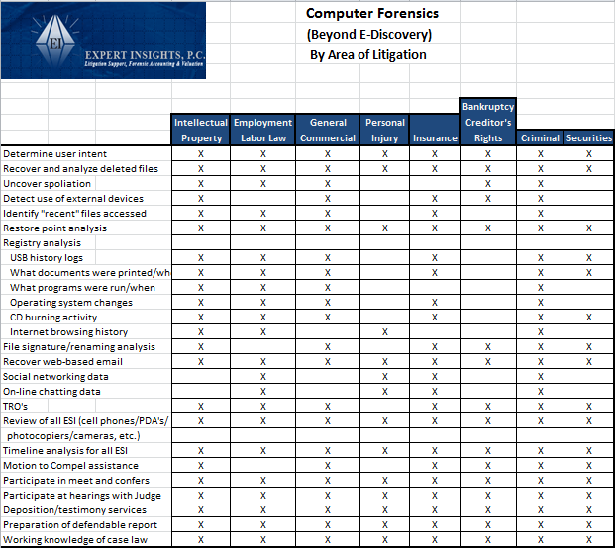
Notes:
Elaborating on Michaels discussion regarding distinguishing between CF and ED, I’ve put together this matrix (handout?)
CF is more proactive/investigative in nature. Used when you want to maximize the amount of relevent information.
For the attorneys out there, I’ll give you a second to identity the type of litigation you are involved in…IP, Commercial including breach of contact, business fraud and shareholder disputes, etc.
Now, cruze along the left hand side to view the type of additional information you can get with computer forensics
-includes recovery of deleted files, uncovering spoliation, when storage devices were connected (as we just saw!)
-restore point analysis – restore points are created by Windows in case your system crashes, you can restore your computer to a point before the crash
normally set to restore every 24 hours
Provides a great forensic tool, you can go back and determine what someone did on their computer on a certain day, even if they think they have covered their tracks
System registry analysis…..
File signature analysis – whether someone tried to change the file name be changing the extension (e.g. from .xls to .brs);
So if you think your e-discovery people are getting all excel doc’s or Word doc’s based on the file extension, they won’t pick up these files that have been renamed…
Michael will show you examples later (more below)…..
Web-based mail/social networking/on-line chatting data – people think they are reaching up to the clouds and these emails are not stored on their computer, however
After you view them on your screen, they are stored in unallocated space and can be recovered (need specialized forensic software) – JUMP TO SLIDE 14.
Review of all ESI (phones, camera’s). I don’t believe “e-discovery vendors” get this info.

Slide 11
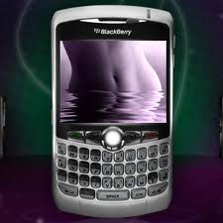
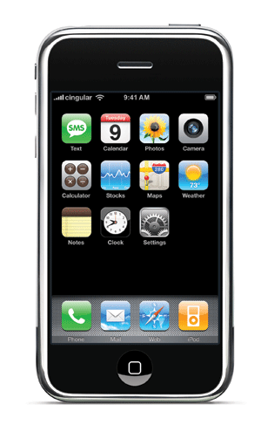
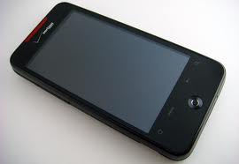
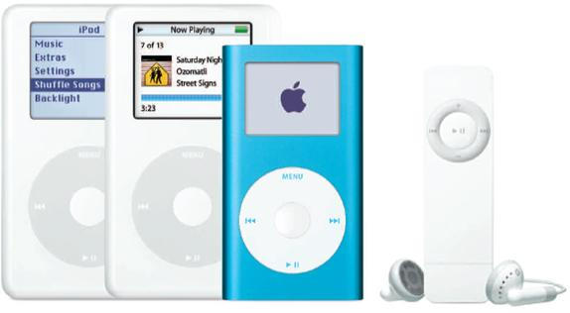
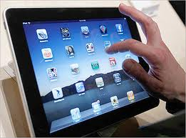
Many Sources of Digital Data
Notes:
The field of information technology is moving so fast that CF is now DF
Text messaging becoming the more common way to communicate (80% of cell phone owners text)
email turning into web mail
Pictures being taken and only viewed digitally, or
More and more infor is being stored right here or in the cloud
So if you want the information you need to win cases, seriously consider these new sources of storage.

Slide 12
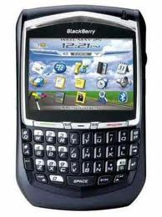
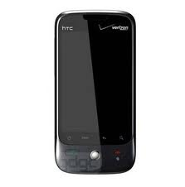
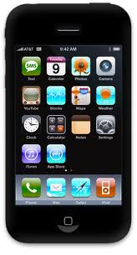
Data on Smartphones
On the Device
Other items uncovered
Call logs
Text messaging
Pictures
SIM card information
Emails and attachments (e.g. Outlook)
Phone directories
Internet history
GPS tracking
Remote access programs (e.g. Log Me In, VNC, Homepipe)
Web based email
Notes:
How many have smartphones? Think about how much information you put on your smartphones. Executives on your cases do the same thing.
These devices are mini computers….
- Critical communication is no longer going to their laptop or desktop computer. It’s stopping right here.
what can you get from them?..........
GPS – go to next slide
They are accessing corporate servers remotely and Believe it or not, files are being downloaded from corporate server onto HH devices OR transferred directly to other locations (cloud storage, competitor website)
ESPEC if they are up to no good and they don’t want info to be found…
The information you may be looking for is stopping right here! – can’t emphasize this enough
Web based mail GO TO SLIDES 14 AND 15

Slide 13
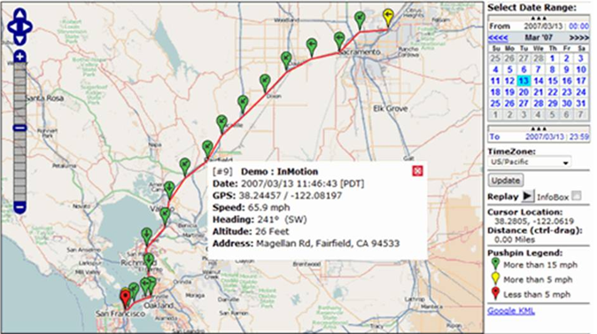
GPS tracking
Notes:
GPS logs can tell you where that phone (and likely the owner) was and when
(Starbucks at this location at such and such time). Then connect that to the overall timetable of your litigation. If someone claims they were in NY at a certain date/time and their cell phone indicates they were in Chicago, plus it has text messages to his wife at that time indicating he is on his way to the White Sox game, he has some explaining to do
GO BACK TO PREVIOUS SLIDE

Slide 14
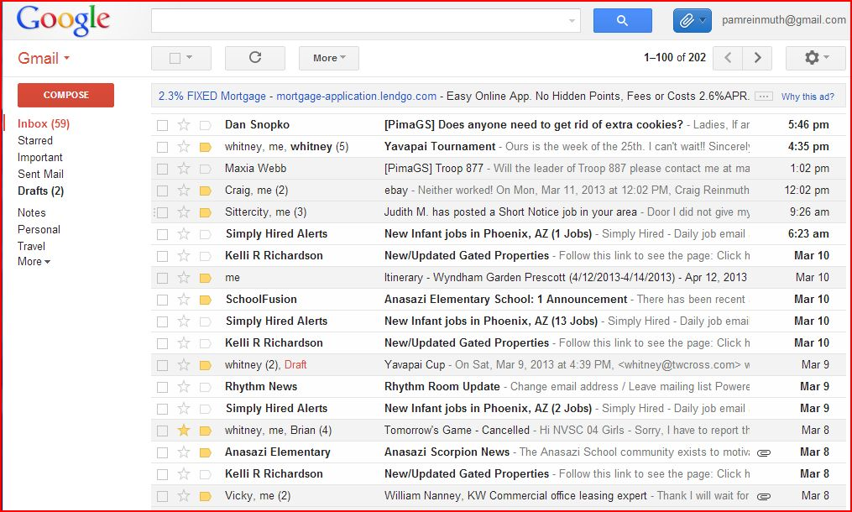
Notes:
Web based mail
-what you view on your computer, an image is retained on your computer or cellphone in unallocated space
-computer forensic software can detect and extract these images

Slide 15
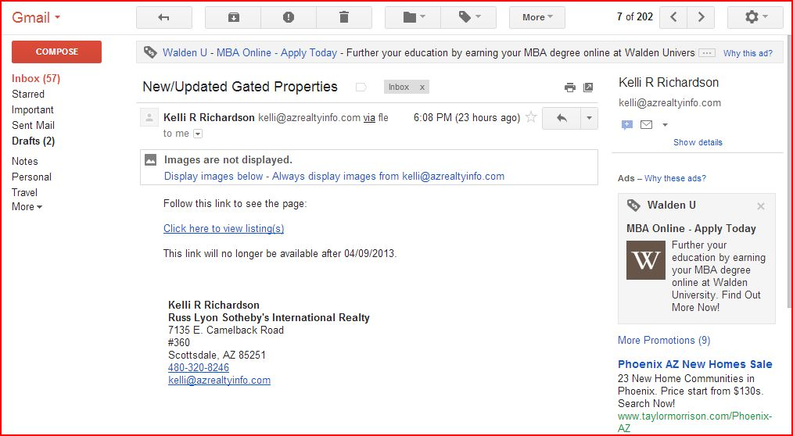
Notes:
GO BACK TO SLIDE 12 FOR CONCLUDING COMMENT

Slide 16
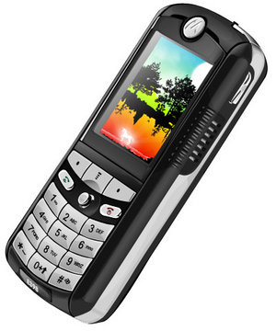
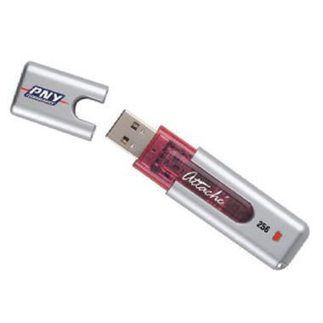
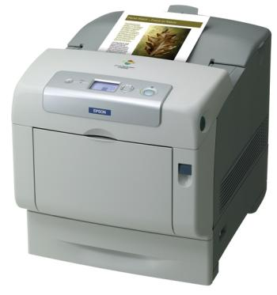
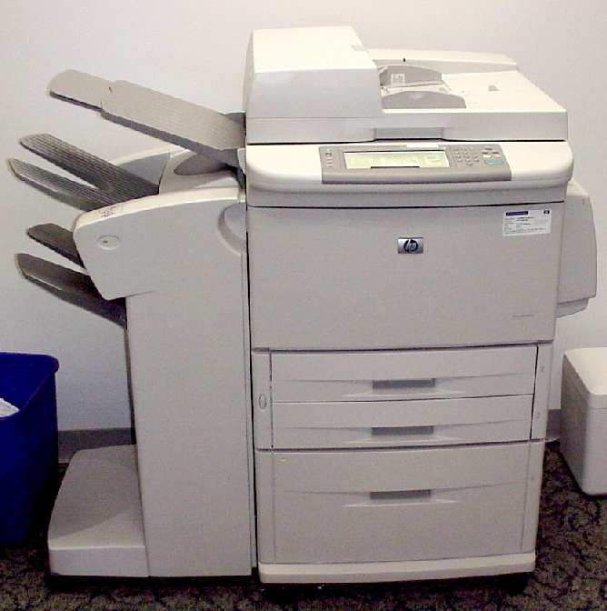
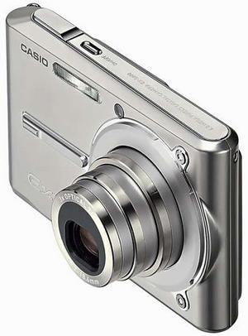
Consider Other ESI Locations
Notes:
Consider all sources of ESI -
Can be forensically obtained and examined.

Slide 17
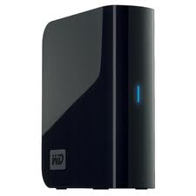
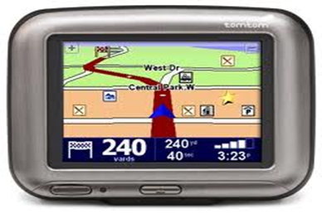
Consider Other ESI Locations
Notes:
GPS devices, and YES, even children’s electronic toys
Back up drive can now easily download the contents of one, but more than one, desktop or laptop drive content
Recent case where FINANCIAL files were hidden on a Kindle!

Slide 18
Get Head Into the Clouds!
“Storing Information Remotely with External Providers”
Notes:
Cloud computing = simply stated: “ storing information remotely with external providers”
Corporations are moving away from having their own “server” and storing data remotely
Cloud storage is here to stay and rapidly growing in popularity
There are ways to forensically obtain this data. Need to be able to get this data from unallocated space

Slide 19
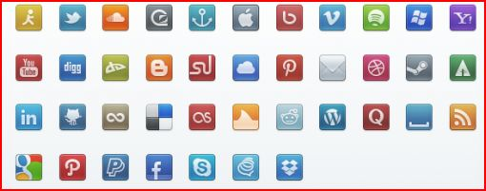
Social Media - Obtainable Data
Notes:
Social media includes social networking sites like:
Facebook – with over 500 million users
Twitter – with over 100 million, with 230 million tweets per day!
also includes web based email
You may not use it, but the people you are going after are likely to, espec if they are younger.
Possibly can be obtained via supboena, although vendors are fighting this; taking strong positions against
Fortunately, there is forensic software that can grab this data to extent it resides in unallocated space on the computer or phone that may be important to your case.

Slide 20
Agenda
What is Computer Forensics and Why is it important?
Computer Forensic Image, Active Files Backup and Hashing
Creating, Deleting and Recovering ESI
Anti-computer Forensics
Alteration of ESI

Slide 21
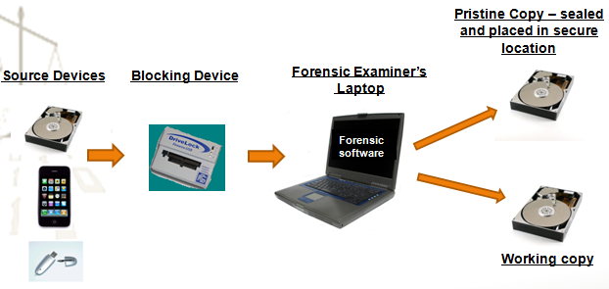
How Examiners Create a Forensic Image

Slide 22
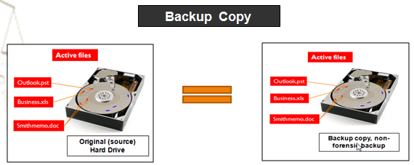
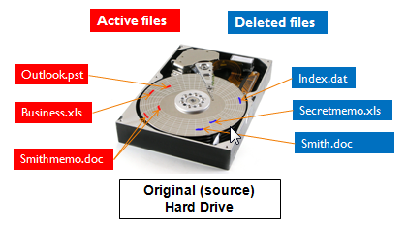
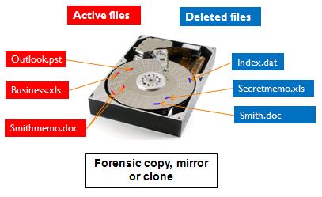
Computer Forensic Image, Active Files Backup and Hashing
Searching for deleted or other residual ESI requires forensic image
Forensic image, mirror or clone vs. backup copy
A “mirror image” is generally described as “a forensic duplicate, which replicates bit for bit, sector for sector, all allocated and unallocated space, including slack space, on a computer hard drive.”
Balboa Threadworks, Inc. v. Stucky, No. 05-1157, 2006 U.S. Dist. LEXIS 29265, at *7-8 (D. Kan. Mar. 24, 2006)
“Backup” or “logical” copy only copies the directory structure and “active” files
Hash sum
Forensic copy
Notes:
If someone does a back up of the drive, will only be able to see what you can see from your computer monitor….you’ve all done this
Hard drive has active files and deleted files on it
In order to search the deleted files, need to make a forensic copy and recover them
A forensic copy is also referred to as a “mirror image”
-bit by bit copy of the entire hard drive

Slide 23
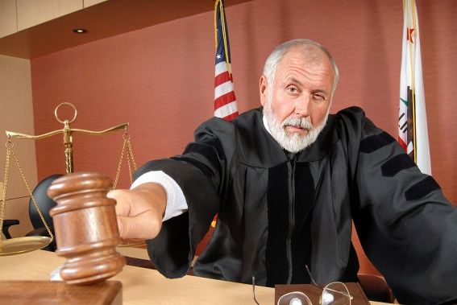
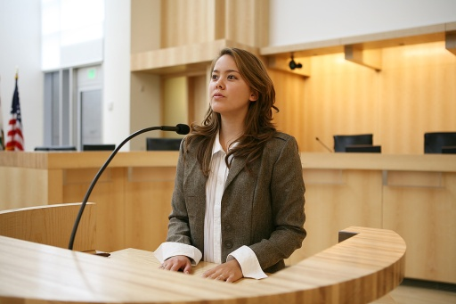
Computer Forensics (cont.)
Request for forensic image generally requires a court order
Reasonable basis
Procedures
Analyzing and interpreting
Expert witness
Licensed required in some states

Slide 24
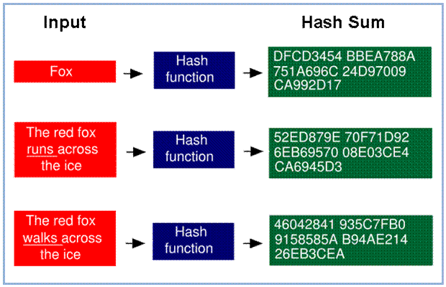
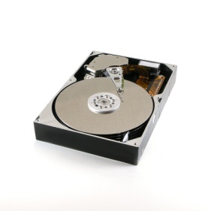
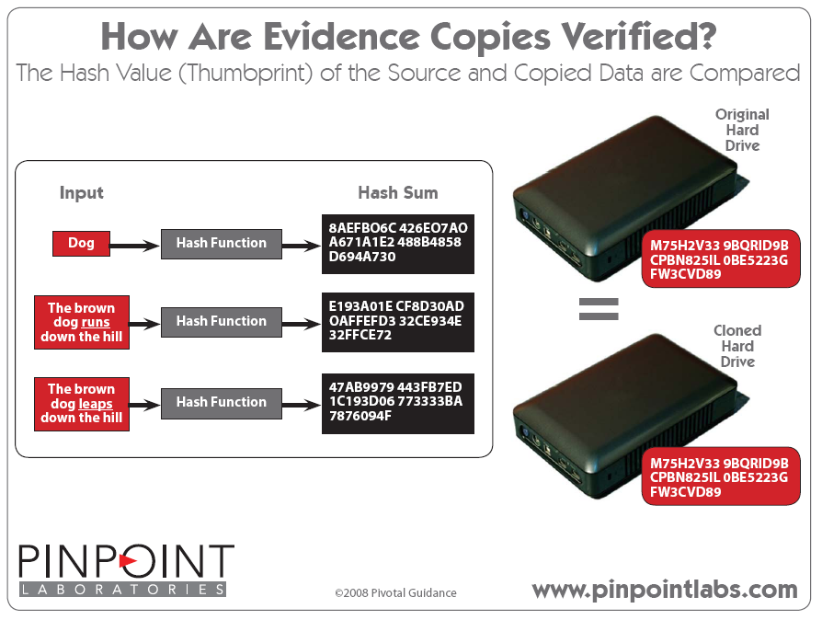
Hashing – Verifying ESI
File level
“Hashing” is used to guarantee the authenticity of an original data set and can be used as a digital equivalent of the Bates stamp used in paper document production.”
Source: Wikipedia,
Cryptographic hash function, at http://en.wikipedia.org/wiki/Cryptographic_hash_function
(last visited June 23, 2010).
Drive level
Original or source drive
Copied or target drive
Hash sum
M76H%V&&9BQHTR9B HGTY834IL0NH5223FFW3XSG65
Hash sum
M76H%V&&9BQHTR9B HGTY834IL0NH5223FFW3XSG65
Notes:
Hashing of the files guarantees the authenticity
Digital equivalent of a bates stamp,
-------------------
so everyone knows they are looking at the same, original document
Hashing is done both at the file and drive level, to assure nothing has been tampered with
Each file has a unique 40 character “hash value”
By looking at this example, you can see how much changes in the hash value when you simply change the word “runs” to “walks”
Alogorithm

Slide 25
Question
Which statement is correct?
1) A "backup" copy of a hard drive will copy deleted information for restoration.
2) A forensic copy of a hard drive will copy only "active" files for examination.
3) Hashing is used to determine the date a computer file was created.
4) A "mirror" image will copy data from the unallocated space of a hard drive and other residual data to another storage media.

Slide 26
Agenda
What is Computer Forensics and Why is it important?
Computer Forensic Image, Active Files Backup and Hashing
Creating, Deleting and Recovering ESI
Anti-computer Forensics
Alteration of ESI
Notes:
There are many forms of ESI that can be created.
Earlier I presented a slide indicating the number of different ways we all use and develop ESI from the time we get up in the morning.
I’d like to share with you an example of a case we worked on and how, with computer forensics, we were able to tie all sources of ESI together and apply it to a case?

Slide 27
IP Case Example – Without Digital Forensics
7/14 (evening) Human Resource Department receives email from EE indicating he/she wants to meet with boss the next day
7/15 Terminates employment
Notes:
Here is a case example that indicates the many ways ESI is created and how it all can be tied together into a timeline
A recent case we worked involvied an employee who left the company to go with a competitor
Your client comes to you and indicates (2 from above)
And that they are suspicious, since she went with a competitor, that she may have taken proprietary info with her
Without computer forensics, this is all your client will know

Slide 28
IP Case – With Computer Forensics
6/6 Warm fuzzies re: business r/ship (gmail)
6/11 Go to social event together (gmail)
6/15 Forwards resume to competitor (gmail)
6/17 Competitor invites EE to meeting on 6/19 (gmail)
6/19 EE attends meeting at competitor office (gmail)
6/20 (Sat) Install 1TB Backup storage device (USB)
6/20 Accesses company projects on server(recent)
6/20 (eve) Accesses company projects on server(recent)
6/20 (eve) Goes to Google documents account (cookie)
6/21 Apple computer in EE possession (deleted email)
6/22 Project files sent to competitor (gmail)
Notes:
With the use of computer/digital forensics we were able to uncover the following…..(look at the paranthetical as to the source of the ESI
Initial gmails discussing the formation of their relationship……
times to get together with competition, including a meeting at competitors office on a Friday 6/19
Through a review of “recent” files, “USB reports” and “Gmails” , and cookies determined dates confidential company project files were accessed and:
Backed up to a 1TB backup drive at the office the following Saturday 6/20
b) Backed up to her Google Documents account and sent to competitor 6/21 and 6/22

Slide 29
Timeline (continued)
6/22-6/28 Employment negotiations (gmail)
6/25 EE connects USB thumb drive in laptop (USB)
6/25 EE accesses server/files from home laptop (recent)
7/8 EE connects card reader for first time (USB)
7/8 Empties trash (recover deleted files)
7/14 (evening):
EE connects same backup drive to laptop (USB)
EE accesses project files from server (recent)
Email indicating EE wants to meet with boss (gmail)
EE communicating with b/friend re: computer on BB (phone)
EE access web mail account; forwards “opportunities” file (internet activity)
7/15 Terminates employment (from client)
Notes:
6/22 – 6/28 employment negotiations back and forth
- also accessing key files and placing on new thumb drive
6/25 Connects storage device, then accesses server files (I’ll let you put 2+2 together)
7/8 She’s packing up and emptying her trash
7/14 Files on 1TB backup drive and places a very important “opportunities” file to competitor via her web mail account
7/14Text messages on her phone to/from her b/friend discussing her frustrations in transferring the corporate data onto the cloud
Fun stuff, Huh?
This is the king of information you can get with computer forensics

Slide 30
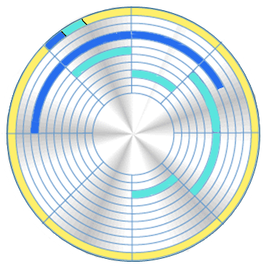
Creating and Writing a File to Disk
File address entry in FAT
File saved to contiguous disk space
File saved to non-contiguous disk space

Slide 31
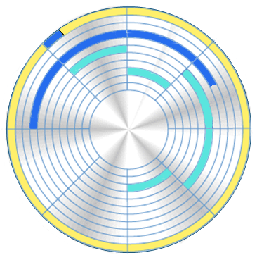
Deleting a File
File address entry in FAT or NTFS is deleted
Data remains on the disk

Slide 32
Demonstration
Evidence establishing attachment of UBS device
File is overwritten and what that looks like
Forensic evidence obtained showing attempt to disguise use of computer – Prefetch file
Wiping program use shown on hard drive
Notes:
Once ESI is created, it can also be destroyed. This can be done in an innoccent # of ways including:
Just continuing to use the computer, even just turning it on, will overwrite data on the hard drive
Creating new files or installing new programs will overwrite files that were previously deleted and placed into unallocated space (demo)

Slide 33
Anti-computer Forensics
Types
Disk cleaning utilities - defragmentation
File and disk wiping utilities
Reformatting
Data hiding – hiding files and directories
Encryption and Steganography
Disk degaussing/Destruction techniques
Source: Anti-computer Forensics, http://en.wikipedia.org/wiki/Anti-computer_forensics
“Attempts to . . . make the analysis and examination of evidence difficult or impossible to conduct.”
Dr. Marc Rogers of Purdue University
Notes:
…Transition
Craig, can you demonstrate some examples of how you have been able to forensically uncover the use of wiping programs?

Slide 34
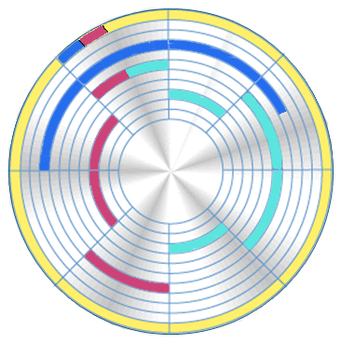
Disk Cleaning Utilities - Fragmentation
Deleted File
Customerlist.xls
File address entry in FAT or NTFS
Active file saved to contiguous disk space
File saved to non-contiguous disk space is generally referred to as disk fragmentation
Active File
BusinessPlan.doc
Notes:
Defragmentation =
files can be saved to non-contiguous disk space (slide 34); spread across or fragmented across the disk
A defragmentation utlility rearranges sectors of data on the drive so they can be accessed quicker
Unfortunately it also overwrites deleted data (happened in Victor Stanley case)

Slide 35
Demonstration
Evidence establishing attachment of UBS device
File is overwritten and what that looks like
Forensic evidence obtained showing attempt to disguise use of computer – Prefetch file
Wiping program use shown on hard drive
Notes:
Wiping -
Can look in the file directory for names of commonly used wiping software
“Eraser”, CCCleaner, Window Washer, GhostSurf
This case – White Canyon, that’s it.
Prefetch file = each time you run an application, Windows creates a pre-fetch file containing info about the files loaded in connection with running the program; speeds up the process next time you use the program
This case dates back to 2010 and was thrown out by the judge due to spoliation of evidence
- (Judge Linda Miles)
Log files may also exist on computer as to what was wiped.

Slide 36
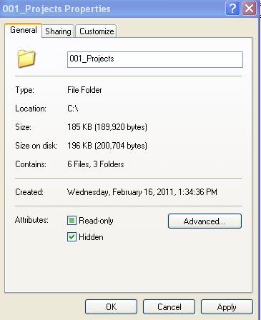
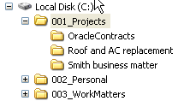
Concealing or Hiding Files and Directories
Changing filename extension
Hidden files and directories
The file name was renamed from License Agreement_Master.doc (Microsoft Word document) to Family picture.jpg (graphic file).
Notes:
This is a problem with targeted collection. Think you’re getting all Word, Excel documents
Also with targeted, usually end up going back and getting entire device/HD later

Slide 37
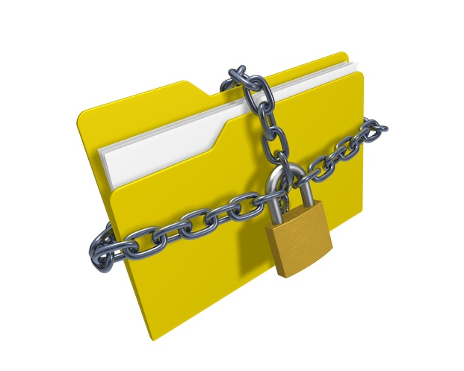
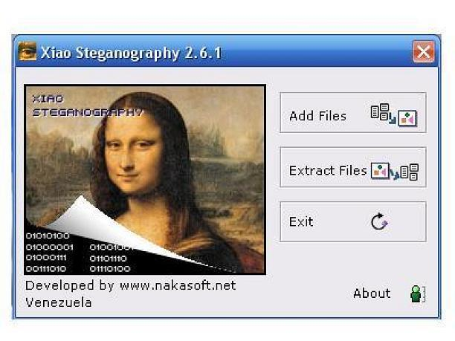
Encryption and Steganography
Encryption
Algorithms
Court order
Pretty Good Privacy (PGP) (www.pgp.com)
Steganography
Message within a graphic image
Steganalysis
Software - Steganos Safe Professional
Source: Nakasoft
Notes:
“[A]ll security keys, encryption/decryption information, and policies that exist or are related to any data . . . for the sole purpose of accessing the data”
Westcoat v. Bayer CropScience LP, No. 06-1529, 2006 U.S. Dist. LEXIS 79756, at *17-18 (D. Mo. Nov. 1, 2006)

Slide 38
Alteration
Alteration of ESI
Difficult to detect
Applies to all media
Chain of custody
Altered or tampered
Forensic analysis – questions of transporting, handling and copying process
Protects integrity of evidence
Who collected it?
How and where was it collected?
Who took possession of it?
How was it stored and protected in storage?
Who took it out of storage and why?

Slide 39
Thank you for participating in this session. .

Slide 40
eDiscovery Educational Opportunities
Arkfeld Online eDiscovery
Training Course
ASU-Arkfeld eDiscovery and
Digital Evidence Conference
Begins Fall and Spring
www.LawCLECenter.com
Eight week course
Once weekly webcast & online classroom
Includes 18 on-demand eDiscovery courses
Preliminary & Post Course Assessments
Certificate of Completion
FREE copy of the Arkfeld on Electronic Discovery and Evidence publications
March 13th – 15th, 2013
www.law.asu.edu/ediscovery
Sandra Day O’Connor College of Law
Arizona State University, Tempe campus
Keynote Speakers
U.S. District Court – Judge Paul Grimm
U.S. Magistrate – Judge John Facciola
Past Webinars
eDiscovery eLearning Series
On Demand - $39.00
www.LawCLECenter.com
Identifying the Deadly Sins of eDiscovery
Cutting Edge Strategies for Effective Discovery Review
On Demand
www.LawCLECenter.com
18 On Demand eDiscovery Courses
Includes Legal & IT content
Partial bundles available!

Slide 41
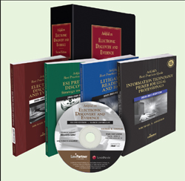
eDiscovery Publications
Arkfeld on Electronic Discovery and Evidence (3rd ed.) treatise published by Law Partner Publishing (www.lawpartnerpublishing.com).
Best Practice Guides: - Information Technology Primer for Lawyers - Litigation Readiness and Hold - ESI Pretrial Discovery - Strategy and Tactics. - Electronic Discovery and Evidence
Companion CD-ROM - contains e-books of all publications, full text of cases and hyperlinked for your convenience.
eLawExchange – www.elawexchange.com
Notes:
In order to fulfill your obligations as a lawyer you must have a solid understanding of computer technology, ESI and its application to legal and ethical rules and case law.
Because of the complexity of this area of the law, it is beyond the scope of this program to cover all of the relevant legal and technology areas. To assist you with understanding computer technology and its application to the practice of law there are additional resources for your consideration. The available resources include:
Arkfeld on Electronic Discovery and Evidence (2nd ed.) treatise
Arkfeld Best Practices Guides which include:
Electronic Discovery and Evidence
Litigation Readiness and Hold
ESI Pretrial Discovery – Strategies and Tactics
IT Primer for Legal Professionals
Judicial Bench Book: Electronic Discovery and Evidence
To review a list of these publications go to Law Partner Publishing web site located at www.lawpartnerpublishing.com.

Slide 42
craig@expertinsights.net www.Expertinsights.net
Craig Reinmuth is President of Expert Insights, P.C., a litigation support firm specializing in the digital forensics and forensic accounting, providing services to legal communities nationwide. Craig is a well-known speaker and article writer in his field. He has testified as an expert witness in Federal District Courts as well as District and Superior Courts in the States of Arizona, California, Nevada and Wisconsin.
Craig particularly enjoys the expert witness testimony aspect of his work wherein he is able to bring facts and insights to judges and juries to assist them in upholding justice in the courtroom. He is known for working with counsel throughout the course of the litigation including strategic planning, pursuing relevant discovery and finding alternate means to obtain it, detailed analysis of discovery and providing clear and convincing testimony.
Professionally, Craig is a Certified Public Accountant, Certified in Financial Forensics, a Chartered Global Management Accountant, and an EnCase Certified Examiner. He is past chairperson for the Business Valuation and Litigation Support Steering Committee for the AZ Society of CPA’s.

